Slide 1
Design Patterns
Template & Command
Gala Islas
Fabian Montemayor
Elias Mera
Maria Paula Anastas

Slide 2
Command
Is a behavioral design pattern in which an object is used to encapsulate all information needed to perform an action or trigger an event at a later time.
Encapsulates a request as an object to allow parameterization of clients with different requests. Decouples the object that invokes the operation from the one that performs it.
Object-oriented callback.

Slide 3
Command
Command decouples the object that invokes the operation from the one that knows how to perform it. To achieve this separation, the designer creates an abstract base class that maps a receiver (an object) with an action (a pointer to a member function).
The base class contains an execute() method that simply calls the action on the receiver.
All clients of Command objects treat each object as a "black box" by simply invoking the object's virtual execute() method whenever the client requires the object's "service".
A Command class holds some subset of the following: an object, a method to be applied to the object, and the arguments to be passed when the method is applied. The Command's "execute" method then causes the pieces to come together.
Sequences of Command objects can be assembled into composite (or macro) commands.

Slide 4
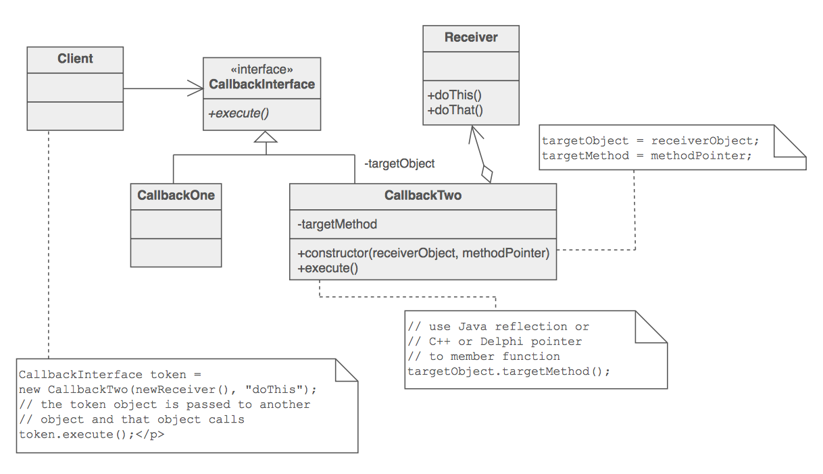

Slide 5
Check list
Define a Command interface with a method signature like execute().
Create one or more derived classes that encapsulate some subset of the following: a "receiver" object, the method to invoke, the arguments to pass.
Instantiate a Command object for each deferred execution request.
Pass the Command object from the creator (aka sender) to the invoker (aka receiver).
The invoker decides when to execute().

Slide 6
Template
Key Points:
Provides a skeleton of an algorithm that allows subclasses to redefine certain aspects.
Base class has placeholders that subclasses fill up.
The steps that always stay the same are implemented on the base class.
It is used in prominently frameworks

Slide 7
Template
The component designer decides which steps of an algorithm are invariant (or standard), and which are variant (or customizable).
The invariant steps are implemented in an abstract base class.
The variant steps represent "hooks", or "placeholders", that can, or must, be supplied by the component's client in a concrete derived class.
Template Method is used prominently in frameworks. Each framework implements the invariant pieces of a domain's architecture, and defines "placeholders" for all necessary or interesting client customization options.

Slide 8
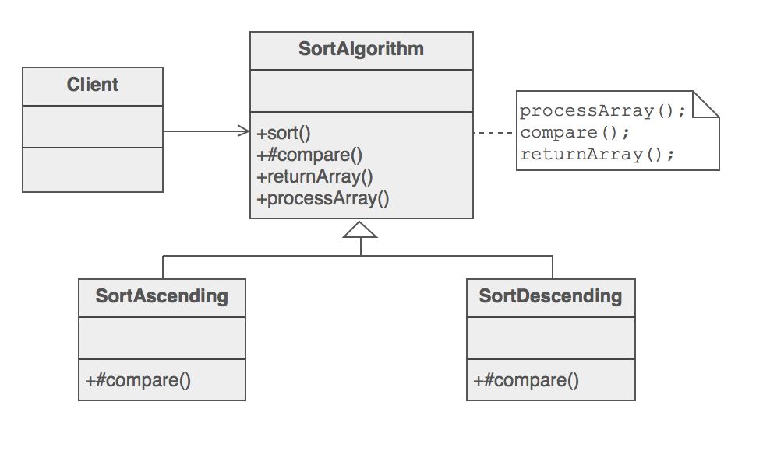

Slide 9
Check list
Examine the algorithm, and decide which steps are standard and which steps are peculiar to each of the current classes.
Define a new abstract base class to host the "don't call us, we'll call you" framework.
Move the shell of the algorithm (now called the "template method") and the definition of all standard steps to the new base class.
Define a placeholder or "hook" method in the base class for each step that requires many different implementations. This method can host a default implementation – or – it can be defined as abstract (Java) or pure virtual (C++).

Slide 10
5. Invoke the hook method(s) from the template method.
6. Each of the existing classes declares an "is-a" relationship to the new abstract base class.
7. Remove from the existing classes all the implementation details that have been moved to the base class.
8. The only details that will remain in the existing classes will be the implementation details peculiar to each derived class.

Slide 11
References
“Design Patterns and Refactoring”. SourceMaking https://sourcemaking.com/design_patterns/command
“Design Patterns and Refactoring”. SourceMaking https://sourcemaking.com/design_patterns/template_method

